Slide 1
Like.com vs. Ugmode Non-infringement arguments
*** CONFIDENTIAL ***
Prepared by Ugmode, Inc

Slide 2
Content-Based Image Retrieval (CBIR)
From Wikipedia:
the application of computer vision to the image retrieval problem, that is, the problem of searching for digital images in large databases.
"Content-based" means that the search will analyze the actual contents of the image.
Well-studied academic field

Slide 3
CBIR Techniques
Basic: (what we do)
Feature analysis
Similarity comparison
Difficult: (what they claim to do)
Object identification/detection
Category classification
Academic state-of-the-art:
Identification only works for specialized objects (faces)
60% classification accuracy (CalTech 101 dataset)
0.45
0.12
Shoe?
Handbag?
Swimsuit?
Other?

Slide 4
Distinguishing Terminology
Feature
Compact, abstract representation for images
e.g. Color histogram: proportion of color components
“Characteristic information”
Numeric values derived by feature analysis from a single image
a.k.a. “feature vector”, “signature”
Distance
Numeric value derived by comparing characteristic information of two images
Relates the (dis)similarity in visual appearance between two images
Key differences:
Like.com uses category-specific features; stores characteristic information.
Modista uses generic features; stores distances.

Slide 5
Modista.com Process
Characteristic
Information
Color Feature Analysis
Similarity Comparison
Distances
Images
Shape Feature Analysis
Characteristic
Information
Data store
Modista uses generic features
and stores distances.
Grid Construction
Distances

Slide 6
Like.com Process
Images
Object Identification
Objects
Category Classification
Category
Category-specific Feature Selection
Features
Objects
Category-specific Feature Analysis
Characteristic Information
Like.com uses category-specific features
and stores characteristic information.
Data store(s)
Search Module
Characteristic Information

Slide 7
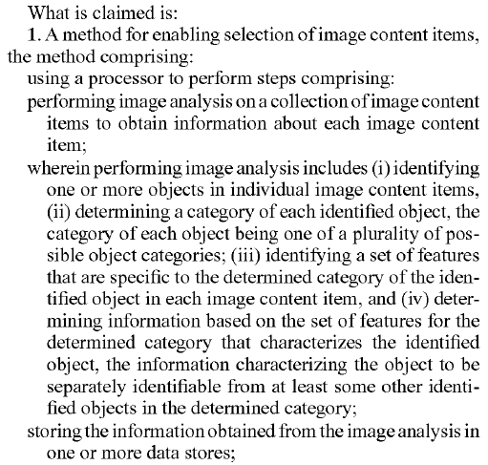
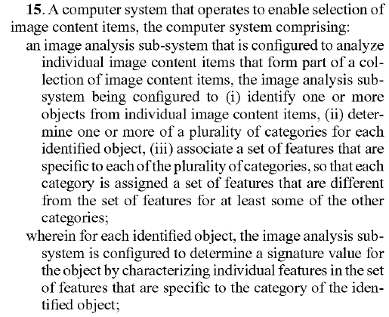
Patent Language

