Slide 1
Like.com vs. Ugmode Invalidity Excerpts
*** CONFIDENTIAL ***
Prepared by Ugmode, Inc.

Slide 2
Summary
US Patent #7,542,610: Application of CBIR to merchandise
25 claims: 2 independent claims, #1 and #15
Have preliminary claim chart for all claims
4, 5, 8, 9, 10, 14 not relevant to our business
None of the prior art listed here was cited in ‘610 prosecution history

Slide 3
Smeulders, et. al (2000)
Survey paper of CBIR
Covers well-known CBIR techniques, including those used in the ‘610 patent
E.g.
‘610 Patent | Smeulders
1. (iii) identifying a set of features that are specific to the determined category of the identified object in each image content item, | Section 2.3: Domain Knowledge "Category-based rules encode the characteristics common to class z of the space of all notions Z. If z is the class of all teapots, the characteristics include the presence of a spout... each application domain has a private set of constraints." “The domain knowledge may take the form of further constraints to the literal image qualities, additional physical or geometrical laws, or domain-specific man-made customs." Section 6.2: Query Specification "the system then selects an appropriate algorithm for segmenting the image and extracting the domain-dependent features."

Slide 4
Gangopadhyay (2001)
Application of CBIR to merchandise
With prototype
E.g.
‘610 Patent | Gangopadhyay
wherein at least some of the collection of image content items correspond to images of merchandise objects; | “The methodology we describe in this paper utilizes visual information, which is an important characteristic for many products such as apparel, designer costumes, interior designs of homes and automobiles, and landscaping.” “… this is one of the first applications of CBIR in the domain of electronic commerce in general and electronic retailing in particular .”
wherein selecting one or more images of merchandise objects for display with the document includes selecting the one or more images based on a determination that the one or more images of merchandise objects are similar to the specified merchandise object; | “The user can then request for other pieces of apparel that will match with the one selected, or other pieces of apparel that are similar to the one selected, based on shape, color, and texture features.”

Slide 5
Supporting documents
Name | Description
aigrain1996cbr | CBIR survey
barsness10624852 | Patent application that analyzes image to generate user-specific advertisements
difazio6418430 | Patent that creates a visual image index for visual information retrieval. Signatures of color, texture, and structure
eakins1999cbir | Overview of CBIR
eidenberger2004vir | Discusses iterative interactive interface for visual information retrieval
frankel1996wis | Web image search engine: data from image content, metadata, and surrounding text
gangopadhyay2000mas | Tech report similar to 2001 paper
gangopadhyay2000eec | Summary paper of shopping-oriented CBIR
liu2003ss | Uses color, shape, and texture to aid in shopping experience
quack2004cortina | Web-scale image retrieval based on visual features and collateral text
sheen2003mde | CBIR search of art on color, shape, and texture.
smith1997vsw | Visual similarity search and automatic type classification (categorization)

Slide 6
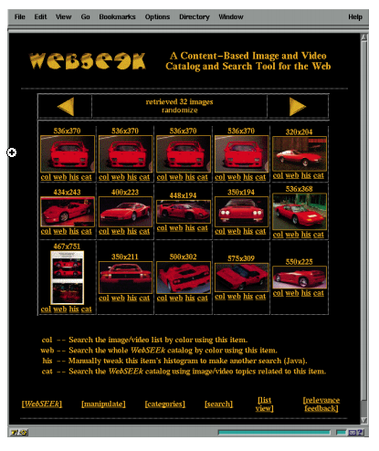
Smith 1997

Slide 7
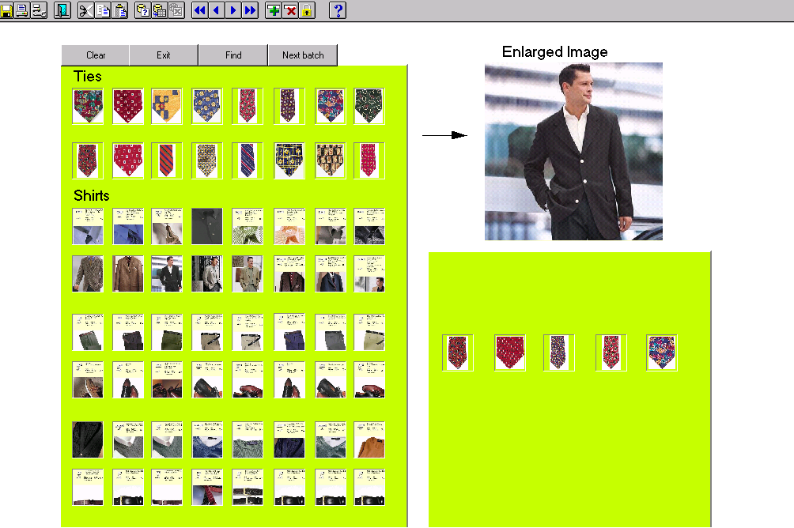
Gangopadhyay 2001

Slide 8
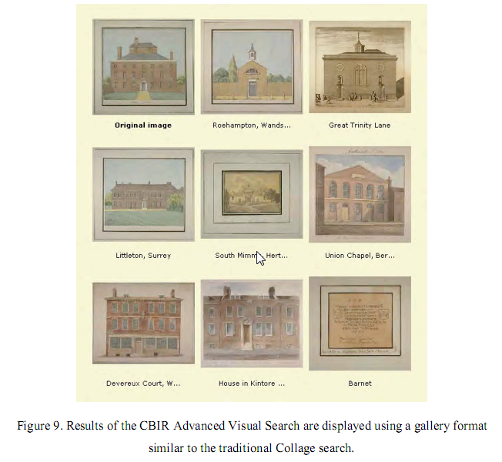
Sheen 2003

Slide 9
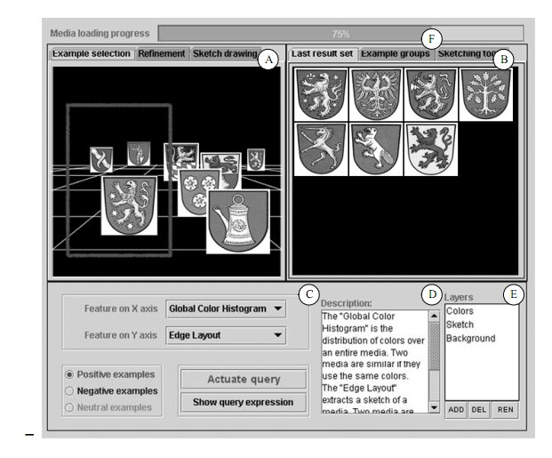
Eidenberger 2003

Slide 10
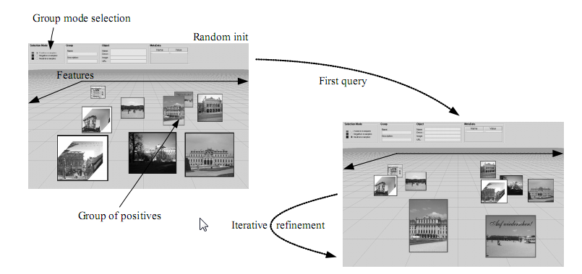
Eidenberger 2004

